Slide 1
Quick Guide To Tsinghua Online Judge
Online Judge Development Team
Oct 17, 2013

Slide 2
Overview
An Introduction to Tsinghua Online Judge
Registration
Signing in OJ
Course Selection
Viewing and Submitting Assignments
About OJ Homework

Slide 3
An Introduction to Tsinghua Online Judge
Tsinghua Online Judge(“OJ”) is mainly used for automatic and standardized assessment and evaluation of programming assignments.
Visiting OJ：
http://dsa.cs.tsinghua.edu.cn/oj
Recommended Browsers：
Internet Explorer 9 and above
Firefox
Chrome
Safari

Slide 4
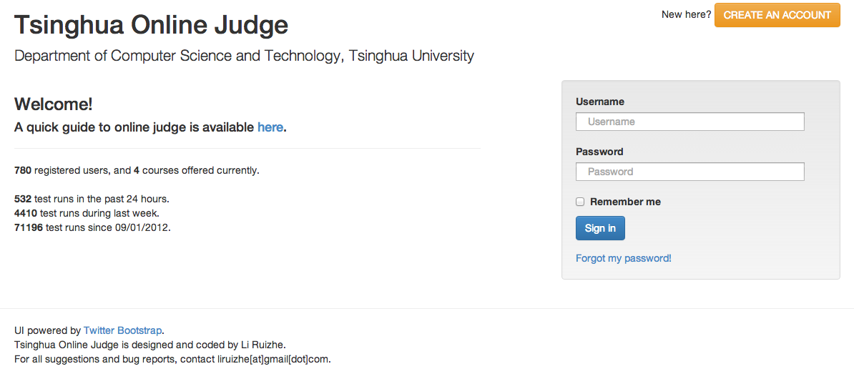
Registration
OJ Address：http://dsa.cs.tsinghua.edu.cn/oj

Slide 5
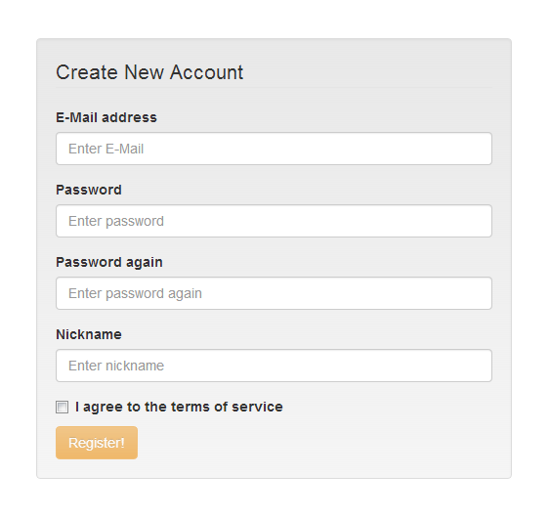
Registration
Type in your e-mail address, password (twice) and nickname / username at the corresponding field
Read the terms of service on the left of the page, then tick the box beside “I agree to the terms of service”。
And then click“Register！”
Within 1-2 minutes, you will receive an e-mail at the address you submitted

Slide 6
Registration
Open your email, click the link provided or copy it to your browser to open it
Your registration is successful if you see the following：

Slide 7
Signing in OJ
Sign in OJ simply by providing your username and password

Slide 8
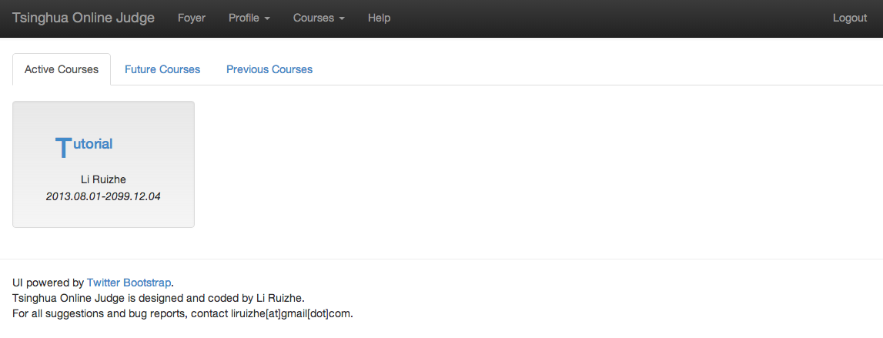
The Main Page after you Log-in
You can select courses here
You can edit your nickname and password here
This is your only course at the moment, through which new users can become familiar to the OJ system.

Slide 9
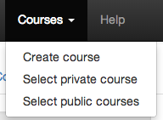
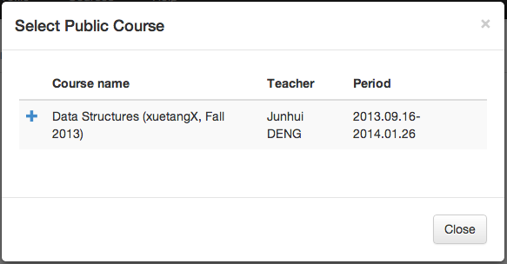
Select Courses
Tsinghua
School
Courses
Type in the code distributed at Internet Courseware, then click OK.
XuetangX / edX
Courses
Click “+” in front of a course to select it

Slide 10
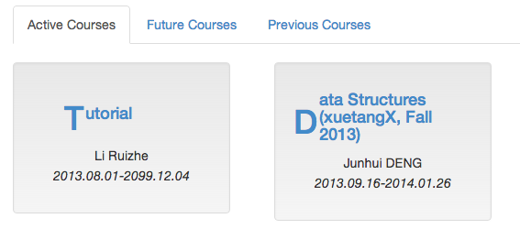
Viewing and Submitting Homework
Click the name of the course
to enter it
Click here to open one batch of homework, which may include several problems. Score of the entire problem set is accumulated.
Deadline
Name of HW, click to
expand and see its content
Current accumulated score，
Only serves as a reference before
deadline. More detailed grading
to come after deadline.

Slide 11
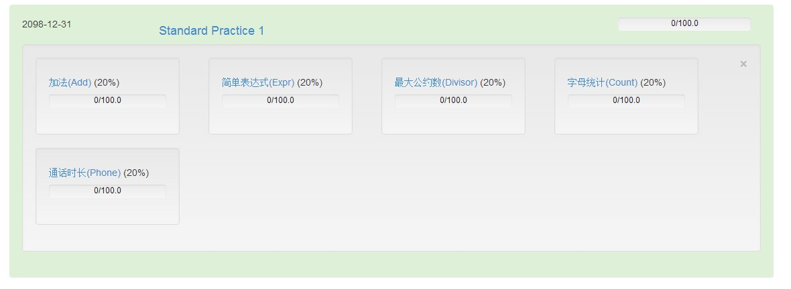
Viewing and Submitting Homework
After opening the content of a HW:
The name of each problem,
its percentage of score within the entire HW
and your current score of this problem
Click the name of the problem to view its details

Slide 12
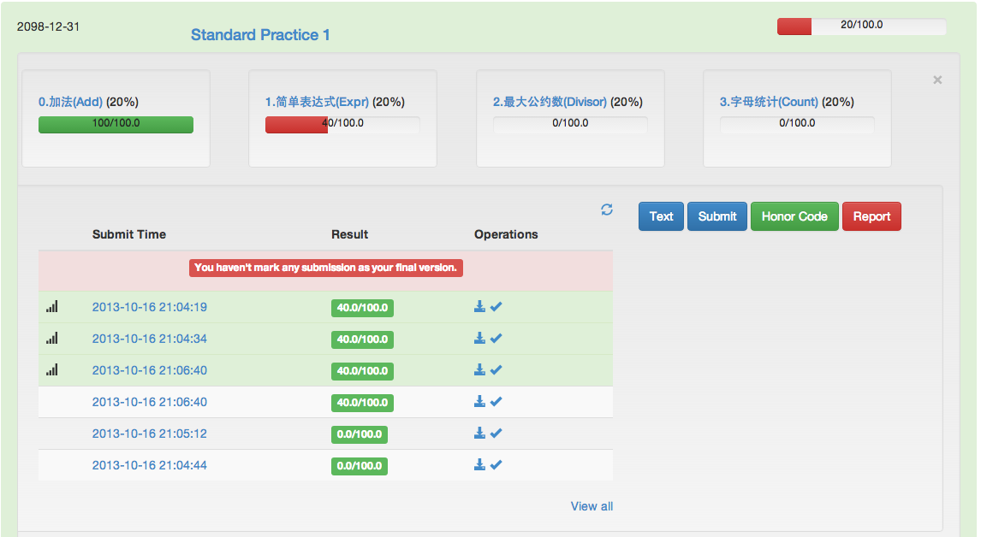
Viewing and Submitting Homework
Submit Program
Text description of the question
Sign Honor code
Upload Problem Report (Unnecessary for XuetangX / edX courses)

Slide 13
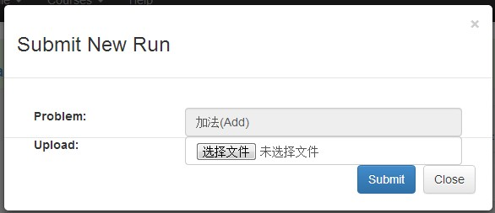
Viewing and Submitting Homework
File for submission：
Single source file
A compressed file with several source files
Maximum size of compressed file: 200K, please delete all unnecessary / temporary files before uploading
Put all your code under the same directory
Supported compressed file format：rar、zip、7z、tar、tar.gz、tar.bz2
Choose your submission file, upload it and click “Submit” – your file is now on OJ!

Slide 14
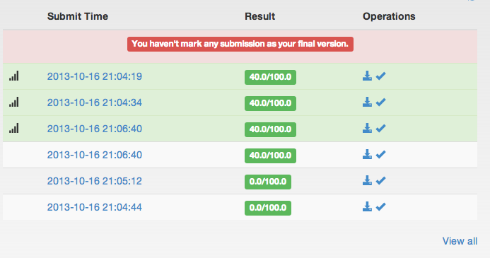
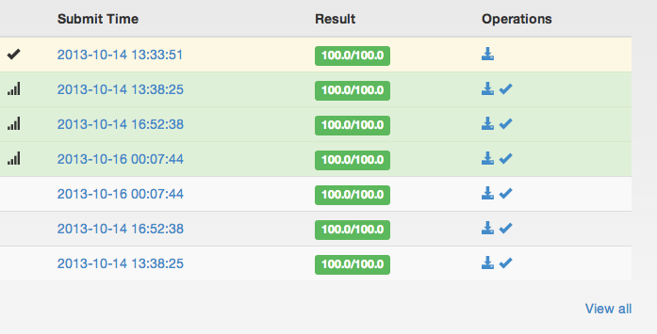
Viewing and Submitting Homework
Mark one submission as your final version for submission. There will be clear warnings if you don’t do so.
(The post-deadline testing utilizes your selected final version)
Download submitted program
Mark the finalized submitted version
Click the date to see a detailed testing report
Your most recent three selections
Your best three selections
View the entire submission history

Slide 15
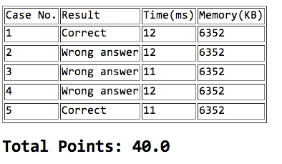
Viewing and Submitting Homework
Click the date before each submission to view a detailed testing report
The testing results, time and memory usage of your program on each cases are all given. Only correct results score points. Each test case has the same amount of points.
Incorrect answers include：
Wrong Answer: incorrect results.
Check the correctness of your algorithm, and input/output format as specified in the problem
Runtime Error: Unhandled errors during the execution of the program.
Common errors: Division by 0, assertion errors, invalid memory access and so on. Please further test your program.
Exceed Time Limit: Exceeds designated running time.
Exceed Memory Limit: Memory usage exceeds limit。
Please further optimize your algorithm and code.

Slide 16
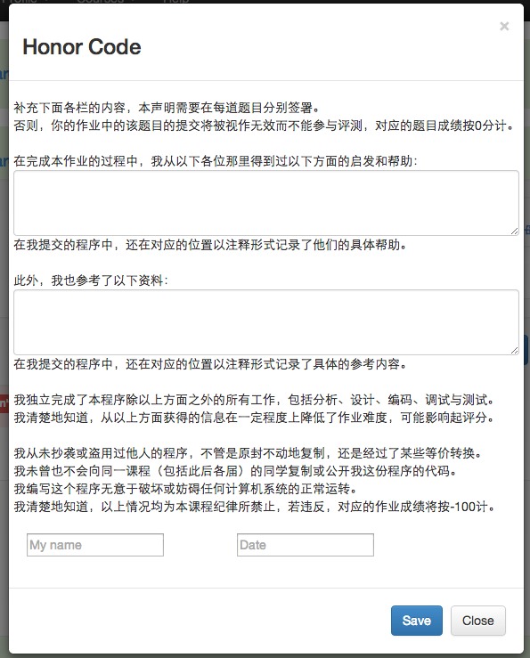
Viewing and Submitting Homework
Signing Honor code
Mention help you received from
others (if any, not required)
Mention any references that
you have used (if any, not required)
Sign your name and date (required)

Slide 17
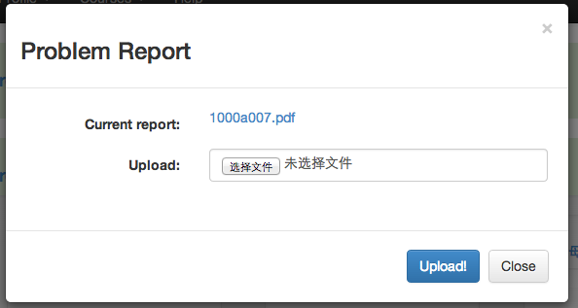
Viewing and Submitting Homework
Upload file to submit your problem report
Each submission overrides the previous one
Click this link to download the current version of your report

Slide 18
About OJ Homework
Use standard I/O (stdin, stdout) to input and output. Unless specified, there should be a space between each data field (integers, float numbers, characters, strings) on one row. The length of a string does not include ‘\0’ at the end, as well as the new-line symbol. There should be no extra space at the end of a line.
Each question has requirements on maximum runtime and memory usage. OJ will force to terminate the program when at least one of the limit is exceeded, and you will receive a 0 for the corresponding test case. Memory usage includes a default part used by OJ to run your program, so the actual memory for use may be slightly lower (~several MB)
There are two parts to the limitations of each problem. For one thing, it constraints the input of each problem, so that it is unnecessary to check for it during testing. For another, it may also limit the allowable methods to solve a problem. No points will be given if these requirements are violated.

Slide 19
About OJ HW
Hints given in each question just refer to one possible method to solve a problem. There may be better ones.
The amount of computation that can be executed in 1 second is about 3*10^8, for example:
If the complexity of an algorithm is O(n^2), then the problem size that can be solved in 1 second is about n <= 10,000;
If the complexity is O(n^3), then the possible problem size is about n<= 600.
Testing occurs before the homework submission deadline.
You are free to test and mark a final version
The final homework score is based on the testing result of your final version
For Tsinghua school course, OJ only uses the first 5 sets of data to test your program during testing stage. Final testing, which takes place after deadline, will use all 10 test cases (where the last 5 will be more difficult than the first 5). The final score will be based on results from final testing.

